Slide 1
Finding Love in Japan and America:
A cross-cultural comparison of college dating
by: Lizet Martinez & Addie Gingold

Slide 2
Outline
Research questions
Significance of the study
Research outline
Research Background
Research Method
Bibliography

Slide 3
Research Questions
What are students perceptions on college dating in Japan and America?
How do dating practices differ between American and Japanese university students?
What do students consider important factors of a “good” date or “bad” date?

Slide 4
Significance of the study
Lizet
While in Japan I had the opportunity to take a class focused on women in Japanese society, our discussions were always interesting and it was in this class that I came across the term 合コン. After speaking friends who at the time were being invited to 合コン, I realized that it was something unique to Japan’s dating culture in that it was so different from what I consider to be “normal” dating culture in America.
This brought up the question, what other differences are there between Japan and Americas dating practices?

Slide 5
Significance of the study
Addie
As a part of an international relationship, while in Japan I was often asked how my culture and my partner’s culture influenced how we built our relationship (告白, meeting families, etc)
In order to avoid any social faux pas, I needed to consult my Japanese peers regarding cultural nuances that affect general dating situations

Slide 6
Research Background
Hook-up: physical intimacy (sex, kissing, etc) without emotional attachment (Bogle, 2008)
Casual dating: or a casual relationship is a physical and emotional relationship between two people who may have casual sex or a near-sexual relationship without necessarily demanding or expecting the extra commitments of a more formal romantic relationship (Bogle, 2008)
Committed Relationship: an emotionally invested relation between people; in terms of this study it will be used to describe a more serious form of dating (Bogle, 2008)

Slide 7
Background continued
Dating values
Extrinsic values: standard of right/wrong, practical application of values (Turner, 2003)
Intrinsic values: values basic on personal experience, everyday behavior (Turner, 2003)

Slide 8
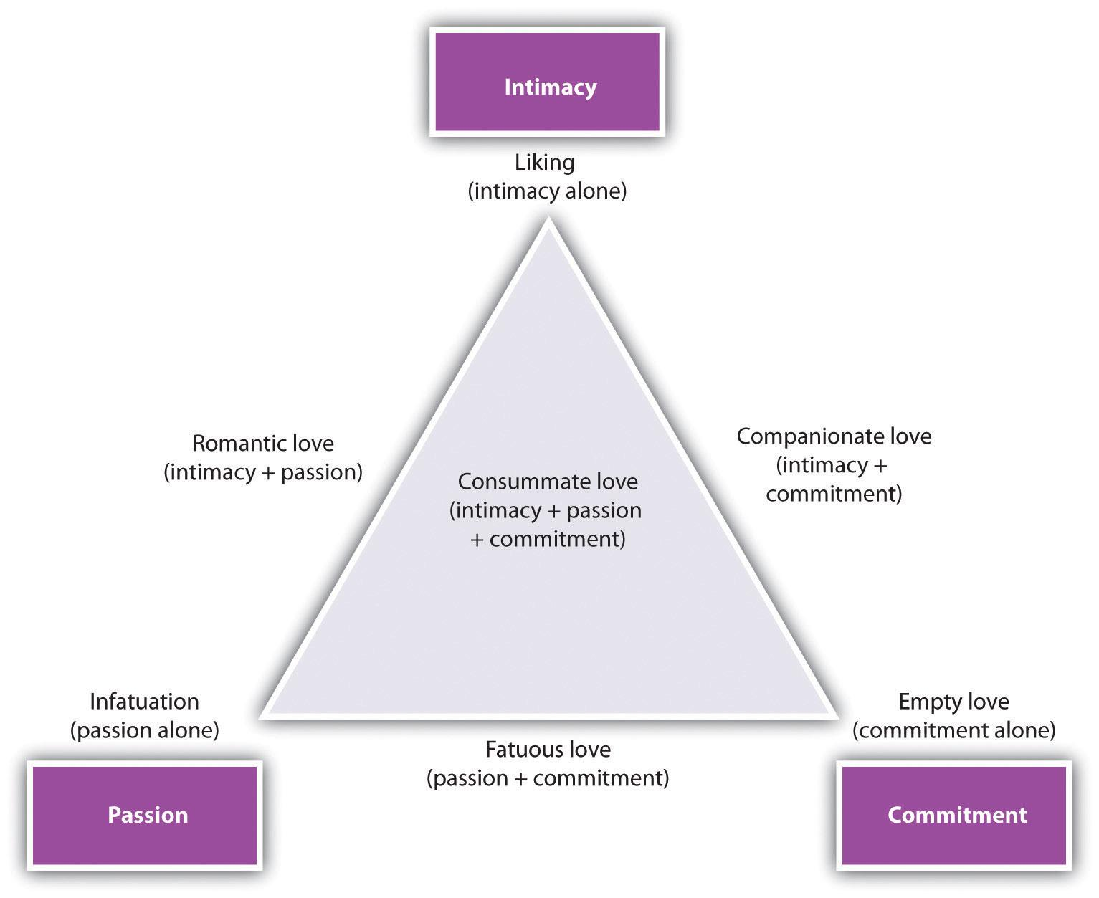
(Turner, 2003)

Slide 9
Background continued
合コン goukon: “combined party”, mixer; for men and women to drink together and become well-acquainted
告白 kokuhaku: profession of love; uses term 好き (love donuts) as opposed to 愛している (explicitly romantic love)

Slide 10
Research Method
Study Participants
About 100 University Students
50 Japanese
50 American
Research Instrument
Online Survey
Personal testimonials (Intracultural Dating)

Slide 11
Bibliography
Bogle, K. (2008). Hooking up sex, dating, and relationships on campus. New York: New York University Press.
Turner, J. (2003). Dating and Sexuality in America : A Reference Handbook. Santa Barbara, Calif: ABC-CLIO.
Hatfield, E. , & Rapson, R. (1996). Love and Sex : Cross-cultural Perspectives. Boston: Allyn and Bacon.
“Courtship, Japanese-Style | Monterey Bay.” Accessed October 14, 2015. http://xerxes.calstate.edu/monterey/articles/record?id=FETCH-proquest_dll_18950593.
“Cross-Cultural Reliability and Validity of the Revised Conflict Tactics Scales: A Study of University Student Dating Couples in 17 Nations | Monterey Bay.” Accessed October 14, 2015. http://xerxes.calstate.edu/monterey/articles/record?id=FETCH-LOGICAL- c23653b95e5263bb187078dcf2da5c76df1b9376144d96cdd4a9c5da48d46e59823b3.

Slide 12
Bibliography continued
“Dating and Sexuality in America : A Reference Handbook | Monterey Bay.” Accessed October 14, 2015. http://xerxes.calstate.edu/monterey/books/record?id=77815.
“Dating, Mating, and Marriage | Monterey Bay.” Accessed October 14, 2015. http://xerxes.calstate.edu/monterey/books/record?id=2474.
“Hooking Up : Sex, Dating, and Relationships on Campus | Monterey Bay.” Accessed October 14, 2015. http://xerxes.calstate.edu/monterey/books/record?id=128274.
Ishida, Hiroshi. “The Transition to Adulthood among Japanese Youths: Understanding Courtship in Japan.” Annals of the American Academy of Political & Social Science 646, no. 1 (March 2013): 86–106. doi:10.1177/0002716212465589.
Kito, Mie. “Self-Disclosure in Romantic Relationships and Friendships Among American and Japanese College Students.” The Journal of Social Psychology 145, no. 2 (April 1, 2005): 127–40. doi:10.3200/SOCP.145.2.127-140.

Slide 13
Bibliography continued
Lesure-Lester, G. Evelyn. “Dating Competence, Social Assertion and Social Anxiety among College Students.” College Student Journal 35, no. 2 (June 1, 2001): 317.
Letcher, Amber1 amber.letcher@sdstate.edu, and Jasmin2 Carmona. “Friends with Benefits: Dating Practices of Rural High School and College Students.” Journal of Community Health 40, no. 3 (June 2015): 522–29. doi:10.1007/s10900-014-9966-z.
“You Are Cordially Invited to Weddings : Dating & Love Customs of Cultures Worldwide, Including Royalty | Monterey Bay.” Accessed October 14, 2015. http://xerxes.calstate.edu/monterey/books/record?id=49303.

